Slide 1
Pre-lecture 9 and 10: Multilevel modelling
Notes:
Hi everyone, this week we’re going to be talking about multilevel modelling, AKA hierarchical modelling, nested data models, mixed models, random coefficient modeling, random-effects models, random parameter models, and etc.

Slide 2
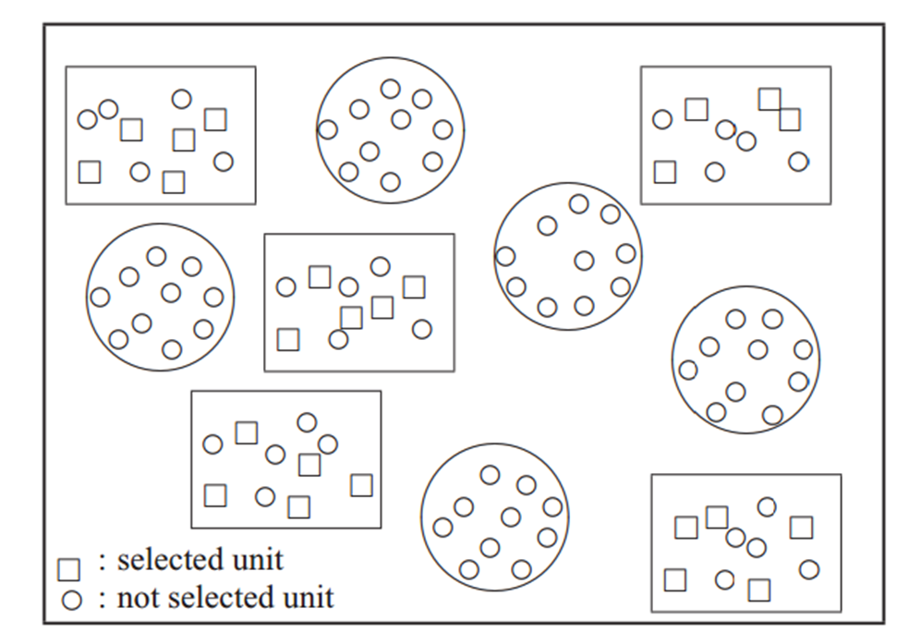
Multistage sampling
Notes:
What are these confusing terms referring to? A statistical technique that allows us to account for grouping in our data and explore how important it is. Often we’re not going to be able to get nice neat datasets where we can randomly sample from an overall population. For example, maybe we want to know about the relationship between socioeconomic status (SES) and educational achievement in children. Ideally we’d be able to sample randomly from all children in the country, but often we will not be able to do so. Instead, we maybe have to rely on two step sampling, where we randomly select schools, and then randomly select children from those schools.

Slide 3
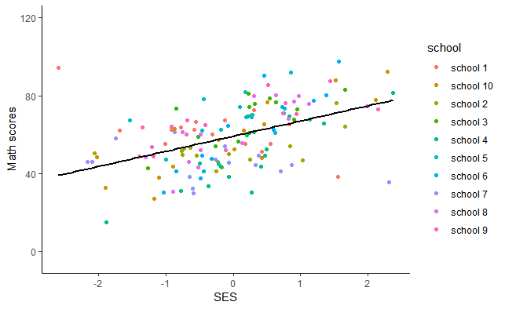
One regression model
Assumes the one model for all schools
Notes:
If we use traditional regression we are almost certainly violating one of the major assumptions of regression – that variables are independently and identically distributed – the nested sampling means that individuals from the same school are not independent of one another. The schools probably have some impact on the Math scores of the kids, and there are also almost certainly differences between schools in the average level of SES.

Slide 4
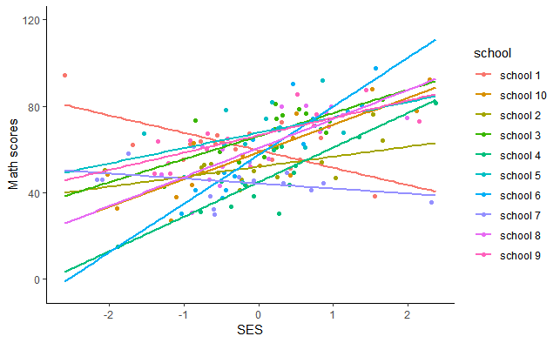
Multilevel modelling
Allows the relationship between math scores and SES to change by school
Notes:
We can avoid this problem using multilevel modelling, where instead of saying that kids have the same average level of math achievement at each school, and that the relationship between SES and math is the same at every school, we say that we expect them to vary.

Slide 5
General linear model: regression
Regression: Y_{ij} = β₀ + β₁₀X_{ij} + ε_{ij}
Notes:
Let’s put this in more concrete terms. I’m going to use the traditional notation, where the subscript indicates the person (the i here) and group (the j here) that each person is in. In normal regression we say that the score of person i in group j is predicted by an overall intercept, beta 0, plus a regression term, beta 10 times that person’s score on variable x, plus some error term which is assumed t assume normally distributed with mean 0 and variance sigma squared

Slide 6
Multilevel modelling
Multilevel modelling: Y_{ij} = γ₀₀ + γ₁₀x _{ij} + u_{1j}x _{ij} + u_{0j} + ε_{ij}
u assumed normally distributed with mean of 0 and variance τ²
ε_{ij} assumed normally distributed with mean 0 and variance σ²
Notes:
In multilevel modelling, we can use a random intercepts and slope model to allow the slopes to differ by group and to allow different schools to have different intercepts To understand this we should introduce some new notation – in MLM, we no longer use beta’s for regression terms, we use gammas – the weirdo y looking Greek letters – don’t worry about the distinction, this is just a notation thing. The main thing you need to be aware of here are the random effects – the U’s. These are no longer parameters that we estimate like regression coefficients, they are random effects, their value is assumed to change by group. This means they do not have a single value that we could plug into this equation, instead we assume that the group values are normally distributed with a mean of 0 and a variance of tau squared. The thing that we are typically interested in about these parameters is how large is tau^2 compared to the overall variance in our model. This very very similar to a traditional error term, only instead of having an error for each person, we now assume that this value is the same for each person in each group. So in the multilevel framework we have
Person I in group j’s score is equal to gamma 00, the overall group intercept, plus gamma 10 times person ij’s score on x, plus u_{1j} times x a random effect times for the group times x – this means that the slope differs for each group, plus a random effect for each group – allowing the group intercepts to vary.

Slide 7
Multilevel models
math_{ij} = γ₀₀ + γ₁₀ses_{ij} + u_{1j}ses_{ij} + u_{0j} + ε_{ij}
Notes:
Let’s make the math into something slightly more comprehendible
This means that person I in group j’s score is equal to and overall intercept, gamma00, plus a regression slope, gamma 10, times their SES score, plus U1j times their SES score, meaning a random effect for group times their SES score – the U1j value is a random effect, meaning that we assume that each group has a different value for u – plus U0j which lets the intercepts differ by group but does not impact the slopes,
plus an error term for each person

Slide 8
Regression models for each school
math_{ij} = 50 + 7 × ses_{ij} + u_{1j}ses_{ij} + u_{0j} + ε_{ij}
math_{ij} = γ₀₀ + γ₁₀ses_{ij} + u_{1j}x _{ij} + u_{0j} + ε_{ij}
Notes:
Lets get our model estimates our. We get values for the fixed effects, but do not get values for the random effects (as they are assumed to differ by group). Instead we will get estimates of how much each of those u’s varies. This means that we can say that person I in group j’s math score is equal to 50, the overall intercept, plus 7 times their ses score, Plus a random effect times their SES score – again, this allows the relationship between SES and math scores to change by group – the random slopes of it all Plus a random effect for each group – this means that we can let the purple group here’s intercept be different from the red group’s for example.

Slide 9
Do not worry, we’re going to build up to that more complicated model over the two MLM weeks.
In week one, we’re going to cover random effects ANOVAs and random intercepts models
In week two, we’re going to go all the way to a random slopes model

Slide 10
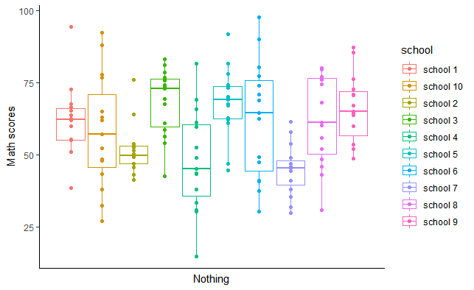
Random effects ANOVA
Y_{ij} = γ₀₀ + u_{0j} + ε_{ij}
Notes:
In random effects ANOVAs we’re only interested in whether the overall scores differ by group – Notice that there is nothing on the y axis, there’s no regression slope, just gamma 00 an overall intercept, and a random effect / a random intercept for group.

Slide 11
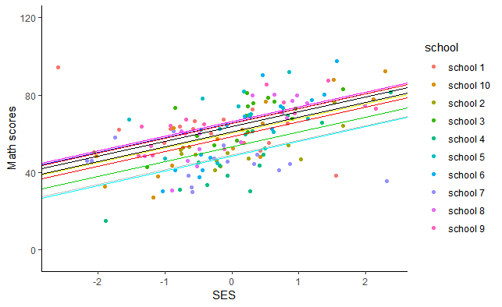
Random intercepts model
Y_{ij} = γ₀₀ + γ₁₀x_{ij} + u_{0j} + ε_{ij}
Notes:
The second model we’ll be building is a random intercepts model. A random intercepts models assumes the slope is the same for everyone, but lets the intercepts differ by group. We can see this is math score for person I in group j = gamma 00 (an intercept for everyone) + gamma 10 times a person’s score on ses (a regression slope for person) + a random effect for each group + a residual for each person The only new part in the random slopes model is that we have the regression slope for the relationship between SES and math scores

Slide 12
Random slopes and intercepts model
Y_{ij} = γ₀₀ + γ₁₀x_{ij} + u_{1j}x_{ij} + u_{0j} + ε_{ij}
Notes:
And finally, we’ll build a random slopes model - a random slopes model allows for different intercepts and different slopes – we can see this as person I in group j’s math score = gamma 00 (and intercept for everyone) + gamma 10 times a person’s score on ses (which is a regression slope that applies to everyone) + a random effect for group times SES, which allows for the relationship between SES and math scores to change by group + plus a random effect for each group (letting group intercepts change) + a residual for each person The only new part for the random slopes model is u_{1j}x_{ij} – the random effects times the person level IV, in our case SES, which lets the slopes vary by group! In week 10’s lecture we’ll even go beyond this! That‘s all!

